Slide 1
Conjunctions
Anna

Slide 2
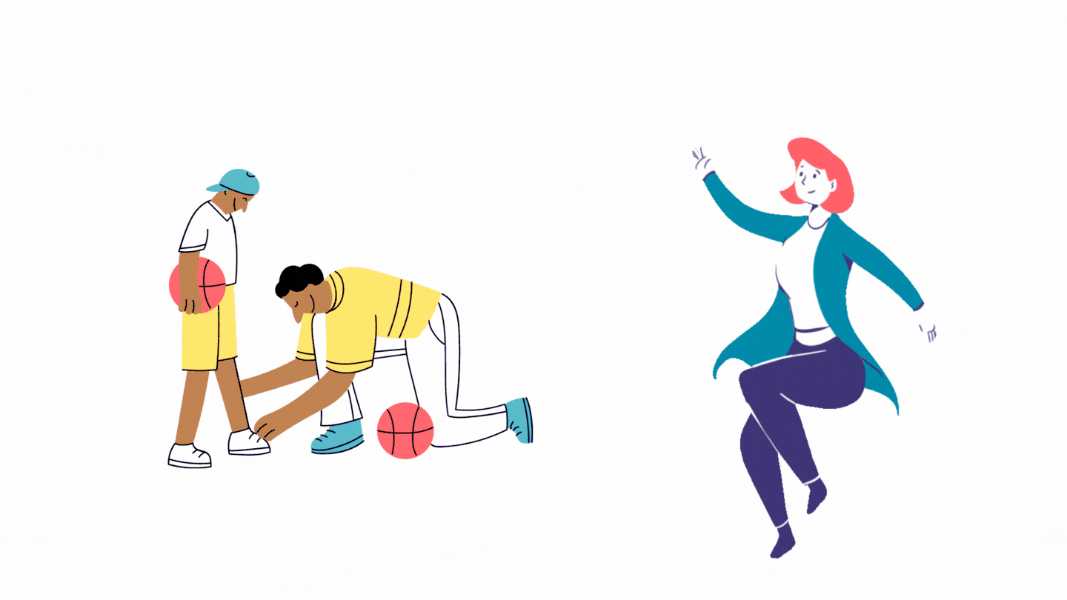
Clauses
Notes:
SHOW THE DIFFERENCE BETWEEN DEPENDENT AND INDEPENDENT CLAUSES

Slide 3
Commas
I was tired after working all day, so I decided to go to bed early. Comma separats two independent sentences.
Since I was tired, I decided to go to bed.

Slide 4
Conjunction Types
Subordinating Conjunctions
Coordinating conjunctions
Correlative Conjunctions
Notes:
They all have their own way of connecting the sentences

Slide 5
Conjunction Types
Subordinating Conjunctions
Coordinating conjunctions
Correlative Conjunctions
Notes:
They all have their own way of connecting the sentences

Slide 6
Subordinating Conjunctions
because
if
although
since
until
while
before
after
Join together an independent and dependent clause
Join together two independent clauses
Notes:
They are called subordinate conjunctions because they joi subordiate clauses or “dependent” to an independent one

Slide 7
Subordinating Conjunctions
Independent + dependent
I want to be President when I grow up.
When I grow up, I want to be a President
Notes:
Notice that subordinate conjunction can appear ether between the clauses or at the start of it.

Slide 8
Subordinating Conjunctions
Independent + independent
I was tired after working all day, so I decided to go to bed early.
Notes:
Notice that subordinate conjunction can appear ether between the clauses or at the start of it.

Slide 9
Conjunction Types
Subordinating Conjunctions
Coordinating conjunctions
Correlative Conjunctions
Notes:
They all have their own way of connecting the sentences

Slide 10
Coordinating Conjunctions
Grammatically equal
two words
two phrases
two independent clauses
FABNOYS
for
and
nor
but
or
yet
so
Notes:
Coordinating conjunctions can join two nouns, verbs, adjectives, or other types of word.
A clause is a group of words that contains at least a subject and a verb. An independent clause can stand on its own as a full sentence, expressing a complete thought.
They can also join different types of phrases.

Slide 11
Coordinating Conjunctions Words Phrases Clauses
The data was collected through questionnaires and interviews.
She usually studies in the library or at a cafe.
We’ve all got both light and dark inside us, what matters is the part we choose to act on. - Sirius Black

Slide 12
Coordinating Conjunctions Clauses
We’ve all got both light and dark inside us, what matters is the part we choose to act on.
We’ve all got both light and dark inside us. What matters is the part we choose to act on.
Notes:
A clause is a group of words that contains at least a subject and a verb. An independent clause can stand on its own as a full sentence, expressing a complete thought.
That Rowing really knew gow to join together independent clauses, doesnt she?

Slide 13
Conjunction Types
Subordinating Conjunctions
Coordinating conjunctions
Correlative Conjunctions
Notes:
They all have their own way of connecting the sentences

Slide 14
Correlative Conjunctions
either … or
neither … nor
not only … but also
and both … and
Used in pairs
Joins words/phrases/similar clauses
Must use parallel structure
Do not need a comma to separate sentences
Notes:
This type of conjunction always Correlative conjunctions must use parallel structure, which means the two elements should take the same grammatical form.comes in a pair and is used to join grammatically equal elements in a sentence.

Slide 15
Correlative Conjunctions Parallel structure
She planned to collect data by either using an online survey or phone interviews.
She planned to collect data by either using an online survey or arranging phone interviews.
Notes:
This type of conjunction always Correlative conjunctions must use parallel structure, which means the two elements should take the same grammatical form.comes in a pair and is used to join grammatically equal elements in a sentence.

Slide 16
How else can you group them?
Connect (for reasons and results)
Constrast
Comparison
Adding points
Notes:
UZDEVUMS. Datu kamera. Ir četras kastītes ar uzrakstiem. sagrupējam šos vārdus
So, therefore, because - and
Nevertheless, although, but
However, whereas, on the other hand (as, as; not as, as), or, instead of
Moreover, in addition, as well as

Slide 17
But did you hear the sentence: sentence with passive voice...
Notes:
Video, kur cilvēks ierunā svarīgu tēmu par iedzimtību (bioloģija)/Zīmola koncepcijas izveide (dizains un tehnoloģijas), Cilvēkkapitāls un ilgtspēja (sociālās zinātnes)
tekstā iesaistīt passive voice un visus linkerus, kas tika iepriekš minēti + uzdevums, kur skolēni var atzīmēt, kuri no vārdiem tika dzirdēti.

Slide 18
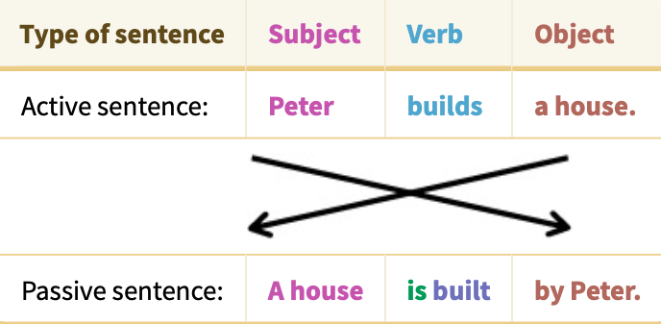
Passive voice
retrieved from: https://www.englisch-hilfen.de/en/grammar/passive.htm

Slide 19
Notes:
šeit iepriekšējā slaida piemēru izraksīt vēl trijos laikos un aizināt skolēnus un padomājot kopā pierakstīt formulu.
Piemēram, Present Simple: Object + to be + V3 + by...

