Slide 1
Guidelines on Correct Conjunction Usage

Slide 2
What shall we study today?

Slide 3
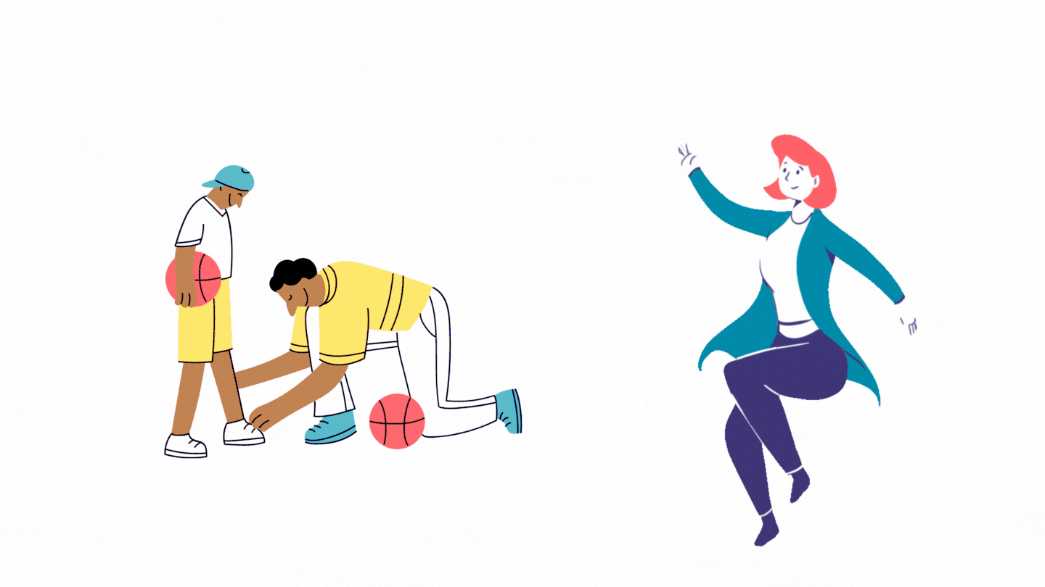
Clauses
Notes:
SHOW THE DIFFERENCE BETWEEN DEPENDENT AND INDEPENDENT CLAUSES

Slide 4
Commas
I was tired after working all day, so I decided to go to bed early. Comma separates two independent sentences.
Since I was tired, I decided to go to bed.

Slide 5
Conjunction Types
Subordinating Conjunctions
Coordinating conjunctions
Correlative Conjunctions
Notes:
They all have their own way of connecting the sentences

Slide 6
Subordinating Conjunctions
because
if
although
since
until
while
before
after
Join together an independent and dependent clause
Join together two independent clauses
Notes:
They are called subordinate conjunctions because they joi subordiate clauses or “dependent” to an independent one

Slide 7
Subordinating Conjunctions
Independent + dependent
I want to be President when I grow up.
When I grow up, I want to be a President
Notes:
Notice that subordinate conjunction can appear ether between the clauses or at the start of it.

Slide 8
Subordinating Conjunctions
Independent + independent
I was tired after working all day, so I decided to go to bed early.
Notes:
Notice that subordinate conjunction can appear ether between the clauses or at the start of it.

Slide 9
Conjunction Types
Subordinating Conjunctions
Coordinating conjunctions
Correlative Conjunctions
Notes:
They all have their own way of connecting the sentences

Slide 10
Coordinating Conjunctions
FANBOYS
for
and
nor
but
or
yet
so
Grammatically equal
two words
two phrases
two independent clauses
Notes:
Coordinating conjunctions can join two nouns, verbs, adjectives, or other types of word.
A clause is a group of words that contains at least a subject and a verb. An independent clause can stand on its own as a full sentence, expressing a complete thought.
They can also join different types of phrases.

Slide 11
Coordinating Conjunctions Words Phrases Clauses
The data was collected through questionnaires and interviews.
She usually studies in the library or at a cafe.
We’ve all got both light and dark inside us, what matters is the part we choose to act on. - Sirius Black

Slide 12
Coordinating Conjunctions Clauses
We’ve all got both light and dark inside us, what matters is the part we choose to act on.
We’ve all got both light and dark inside us. What matters is the part we choose to act on.
Notes:
A clause is a group of words that contains at least a subject and a verb. An independent clause can stand on its own as a full sentence, expressing a complete thought.
That Rowing really knew gow to join together independent clauses, doesnt she?

Slide 13
Conjunction Types
Subordinating Conjunctions
Coordinating conjunctions
Correlative Conjunctions
Notes:
They all have their own way of connecting the sentences

Slide 14
Correlative Conjunctions
either … or
neither … nor
not only … but also
and both … and
Used in pairs
Joins words/phrases/similar clauses
Must use parallel structure
Do not need a comma to separate sentences
Notes:
This type of conjunction always Correlative conjunctions must use parallel structure, which means the two elements should take the same grammatical form.comes in a pair and is used to join grammatically equal elements in a sentence.

Slide 15
Correlative Conjunctions Parallel structure
She planned to collect data by either using an online survey or phone interviews.
She planned to collect data by either using an online survey or arranging phone interviews.
Notes:
This type of conjunction always Correlative conjunctions must use parallel structure, which means the two elements should take the same grammatical form.comes in a pair and is used to join grammatically equal elements in a sentence.

Slide 16
How else can you group them?
Connect (for reasons and results)
Constrast
Comparison
Adding points
Notes:
UZDEVUMS. Datu kamera. Ir četras kastītes ar uzrakstiem. sagrupējam šos vārdus
So, therefore, because - and
Nevertheless, although, but
However, whereas, on the other hand (as, as; not as, as), or, instead of
Moreover, in addition, as well as

Slide 17
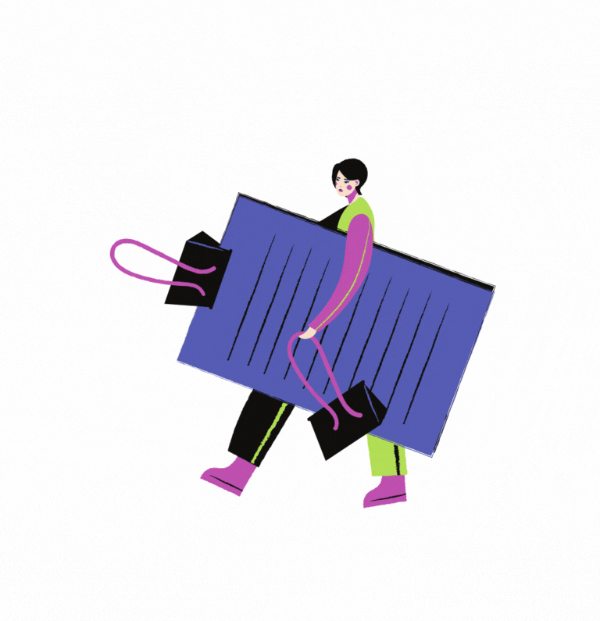
The task
Watch the video and tick the box next to the conjunction that you hear.
Notes:
the task : to listen to the cnj that you hear in the video

Slide 18
and
however
while
or
so
that
not only..but also
although
therefore
The task
Watch the video and tick the box next to the conjunction that you hear.
Notes:
the task : to listen to the cnj that you hear in the video

Slide 20
and
however
while
or
so
that
not only..but also
although
therefore
The answer
Notes:
the task : to listen to the cnj that you hear in the video

Slide 21
Though, did you hear the sentence: Genetic information is passed from one generation to the next.
Notes:
Video, kur cilvēks ierunā svarīgu tēmu par iedzimtību (bioloģija)/Zīmola koncepcijas izveide (dizains un tehnoloģijas), Cilvēkkapitāls un ilgtspēja (sociālās zinātnes)
tekstā iesaistīt passive voice un visus linkerus, kas tika iepriekš minēti + uzdevums, kur skolēni var atzīmēt, kuri no vārdiem tika dzirdēti.

Slide 22
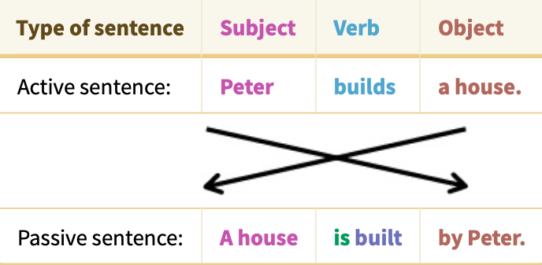
Passive voice
retrieved from: https://www.englisch-hilfen.de/en/grammar/passive.htm

Slide 23
Notes:
šeit iepriekšējā slaida piemēru izraksīt vēl trijos laikos un aizināt skolēnus un padomājot kopā pierakstīt formulu.
Piemēram, Present Simple: Object + to be + V3 + by...

Slide 24
Let us recap!
Explore grammar in various contexts!
Study the topic of conjunctions!
Use the conjunctions wisely!

Slide 25
THANK YOU!

